Slide 1
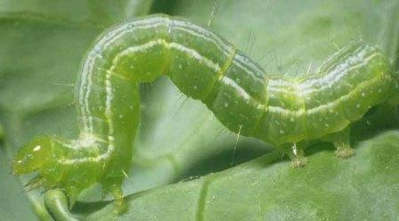
Daily Review
Reminder:
Observations are statements of fact using numbers or descriptions Inferences are an explanation of an observation
Which one of the following is the observation and which is the inference? Explain your choice
The caterpillars ate all the leaves on the rose bush, but not the daisy bush.
Caterpillars prefer to eat rose leaves.

Slide 2
Daily Review
Reminder:
What you are are trying to find an answer to is the question An aim is what you are trying to achieve in an experiment A hypothesis is a testable statement
O: The caterpillars ate all the leaves on the rose bush, but not the daisy bush.
I: Caterpillars prefer to eat rose leaves.
Identify the question, the aim and the hypothesis.
Do caterpillars prefer eating rose leaves to other types of leaves?
Caterpillars eating rose leaves more than other types of leaves.
To find out if caterpillars prefer to eat rose leaves.

Slide 3
Scientific Method: Variables

Slide 4
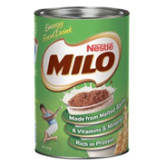
Learning Objective
CFU
What are we going to learn today?
Identify the three types of variables in an experiment.
Activate Prior Knowledge
When people make a cup of milo, there are many different ways they can make it.
Think, pair, share: What are some of the things that can be different when people make a cup of milo?
Vocabulary
Variable: something that can affect the outcome of an experiment

Slide 5
Concept Development
CFU 1
What is a variable?
To make sure an experiment is fair, scientists must identify and control variables that may affect the experiment.
CFU 2
What is an independent variable?
There are three types of variables in an experiment.
Independent variable: the one that is deliberately changed
Dependent variable: the one that is tested or measured
Controlled variables: the ones that are kept the same to make the experiment fair
The HYPOTHESIS is a testable statement relating the independent variable (stated first) to the dependent variable.
CFU 3
What is a dependent variable?
CFU 4
Why do you need to control variables?
Vocabulary
Variable: something that can affect the outcome of an experiment

Slide 6
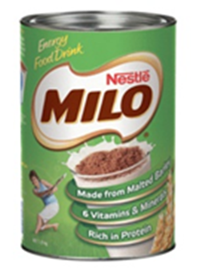
Skill Development/Guided Practice
CFU 1
What is being deliberately changed in the experiment?
To make sure an experiment is fair, scientists must identify and control variables that may affect the experiment.
Aim: To find out if the temperature of milk affects how fast milo dissolves
Independent variable (changed): Temperature of milk
Dependent variable (measured): How fast the milo dissolves
Controlled variables (kept the same): Amount of milo and amount of milk
Hypothesis – As the temperature of the milk increases, the amount of milo dissolved increases.
CFU 2
What is being measured in the experiment?
CFU 3
What should be kept the same in the experiment?
Vocabulary
Variable: something that can affect the outcome of an experiment

Slide 7
Skill Development/Guided Practice
CFU 1
What is being deliberately changed in the experiment?
To make sure an experiment is fair, scientists must identify and control variables that may affect the experiment.
CFU 2
What is being measured in the experiment?
Aim: To find out if watering plants with fertiliser makes them grow faster.
Independent variable (changed): Amount of fertiliser
Dependent variable (measured): How fast the plants grow
Controlled variables (kept the same):
Hypothesis- As the amount of fertilizer increases, plant growth increases.
CFU 3
What should be kept the same in the experiment?
Vocabulary
Variable: something that can affect the outcome of an experiment

Slide 8
Skill Development/Guided Practice
CFU 1
What is being deliberately changed in the experiment?
To make sure an experiment is fair, scientists must identify and control variables that may affect the experiment.
CFU 2
What is being measured in the experiment?
Aim: To find out if smaller pieces of ice melt faster than larger pieces.
Independent variable (changed):
Dependent variable (measured):
Controlled variables (kept the same):
Hypothesis ( independent vs dependent)
CFU 3
What should be kept the same in the experiment?
Vocabulary
Variable: something that can affect the outcome of an experiment

Slide 9
Relevance
Understanding the different types of variables will help you to plan a fair experiment, changing only one variable at a time.
Vocabulary
Variable: something that can affect the outcome of an experiment

Slide 10
Skill Closure
Aim: To find out if warmer conditions make mould grow faster.
For the aim above, what is the independent variable (changed)?
Skill Closure
For the aim above, what is the dependent variable (measured)?
Skill Closure
For the aim above, what are two controlled variables (kept the same)?

Slide 11
Independent Practice
Reminder:
Independent variable is the one that is deliberately changed
Dependent variable is the one that is tested or measured
Controlled variables are kept the same
Identify the variables in the following experimental purpose:
To find out if the amount of food given to fish affects their weight
To find out if the type of food affects how quickly mould grows
To find out if temperature affects how quickly water evaporates

Slide 12
Independent Practice
Either on Connect or a paper copy, complete the worksheet on variables.

Slide 13
Daily Review
Reminder:
Independent variable is the one that is deliberately changed
Dependent variable is the one that is tested or measured
Controlled variables are kept the same
Identify the variables in the following experimental purpose:
To find out if the temperature of the water affects how fast salt dissolves.

Slide 14
Daily Review
Reminder:
Independent variable is the one that is deliberately changed
Dependent variable is the one that is tested or measured
Controlled variables are kept the same
Identify the variables in the following experimental purpose:
To find out if different types of water boil at different temperatures.

